Slide 1
The Otta admin portal
How the Otta team runs the book: applications, enquiries, brokers and policies
FOR OTTA TEAM
Notes:
The Otta admin portal. How the Otta team runs the book: applications, enquiries, brokers and policies.

Slide 2
What this module covers
1
Signing in and the overview
2
Applications and underwriting
The dashboard, live activity and what needs attention.
Reading an application with the underwriting assistant and filling the V13 worksheet.
3
Enquiries and brokers
4
Quotes, policies and email
Website enquiries, approving portal access and managing brokers.
Bind instructions, the policy book and checking email delivery.
Notes:
What this module covers. Signing in and the overview: The dashboard, live activity and what needs attention. Applications and underwriting: Reading an application with the underwriting assistant and filling the V13 worksheet. Enquiries and brokers: Website enquiries, approving portal access and managing brokers. Quotes, policies and email: Bind instructions, the policy book and checking email delivery.

Slide 3
Signing in and the overview
01
The overview shows the whole book across every brokerage, and what needs action today.
Notes:
Signing in and the overview. The overview shows the whole book across every brokerage, and what needs action today.

Slide 4
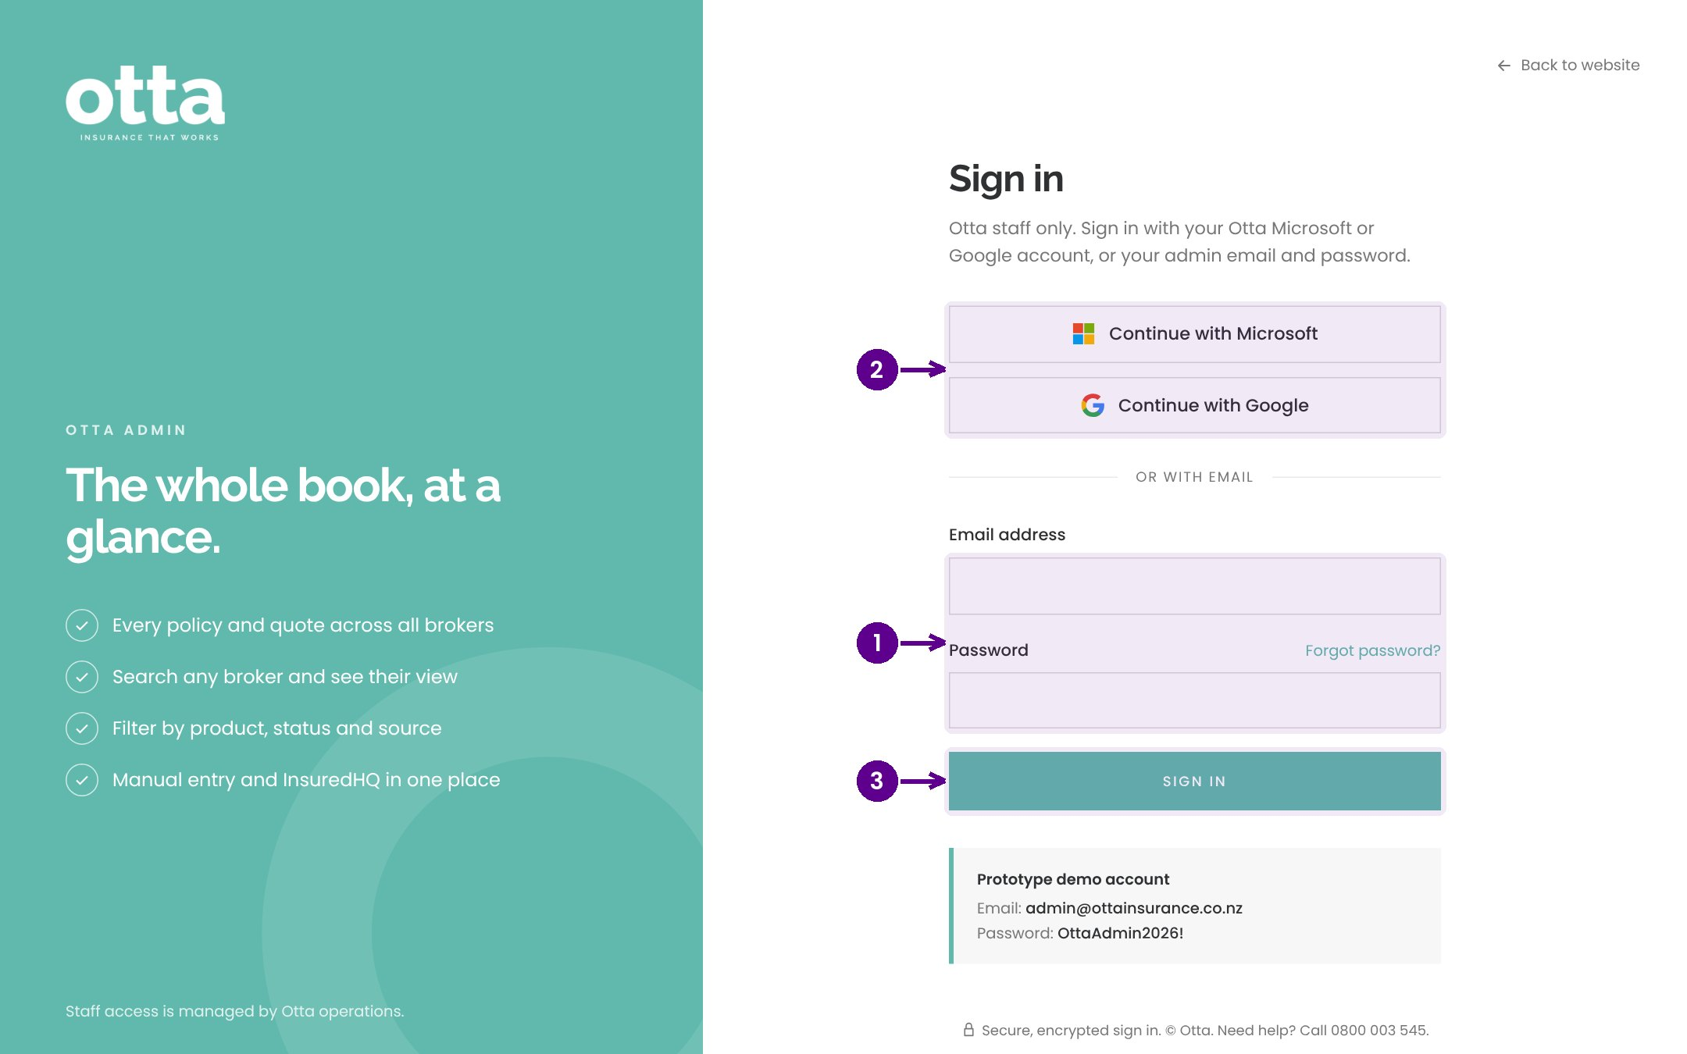
Signing in
1
Your Otta email and password.
2
Or sign in with Microsoft or Google.
3
Select Sign in.
Notes:
The admin portal is for the Otta team only. Sign in with your Otta email and password, or use your Microsoft or Google work account.

Slide 5
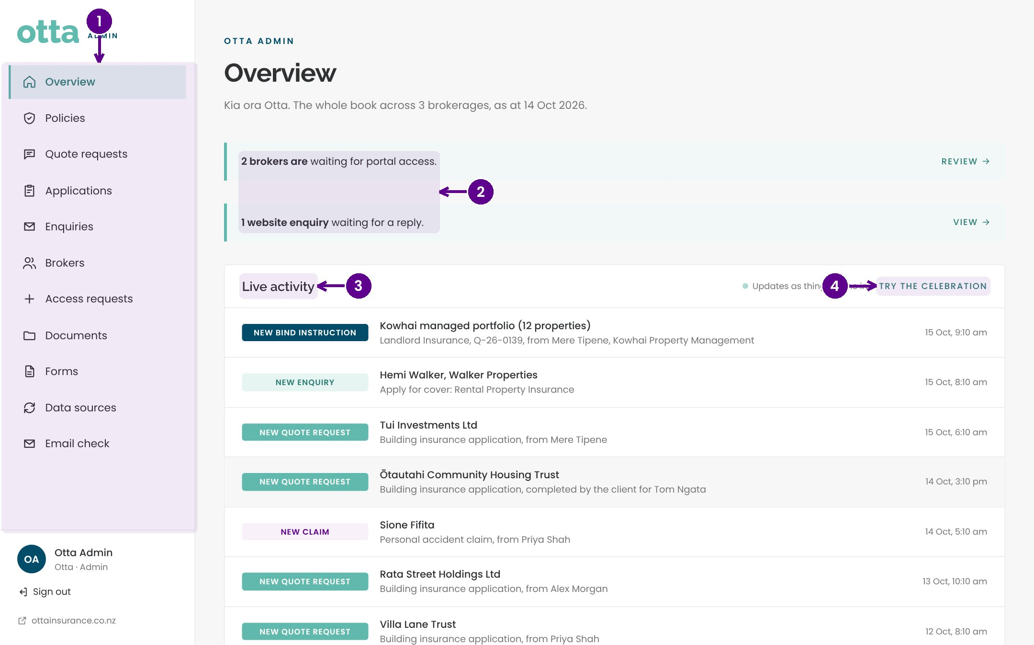
The overview
1
The menu: every area of the admin portal.
2
Things waiting on you: access requests and unanswered enquiries.
3
Live activity: new enquiries, quote requests, claims and bind instructions as they arrive.
4
Try the celebration plays the pop you'll see when something new comes in.
Notes:
The overview is the home page. On the left is the menu. At the top, banners show anything waiting on you, such as brokers asking for portal access or website enquiries that need a reply. Live activity lists everything new, most recent first. It updates on its own every few seconds.

Slide 6
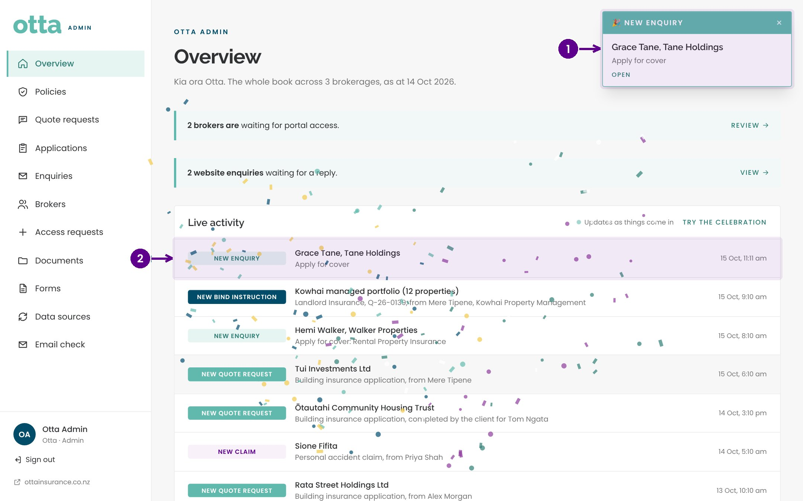
When something new arrives
1
A confetti pop and a card say what has arrived. Select it to open it.
2
It is added to the top of Live activity.
Notes:
Whenever a new enquiry, quote request or bind instruction arrives while you have the admin portal open, you'll see a confetti pop and a card naming what came in. Select the card to go straight to it. You don't need to refresh the page.

Slide 7
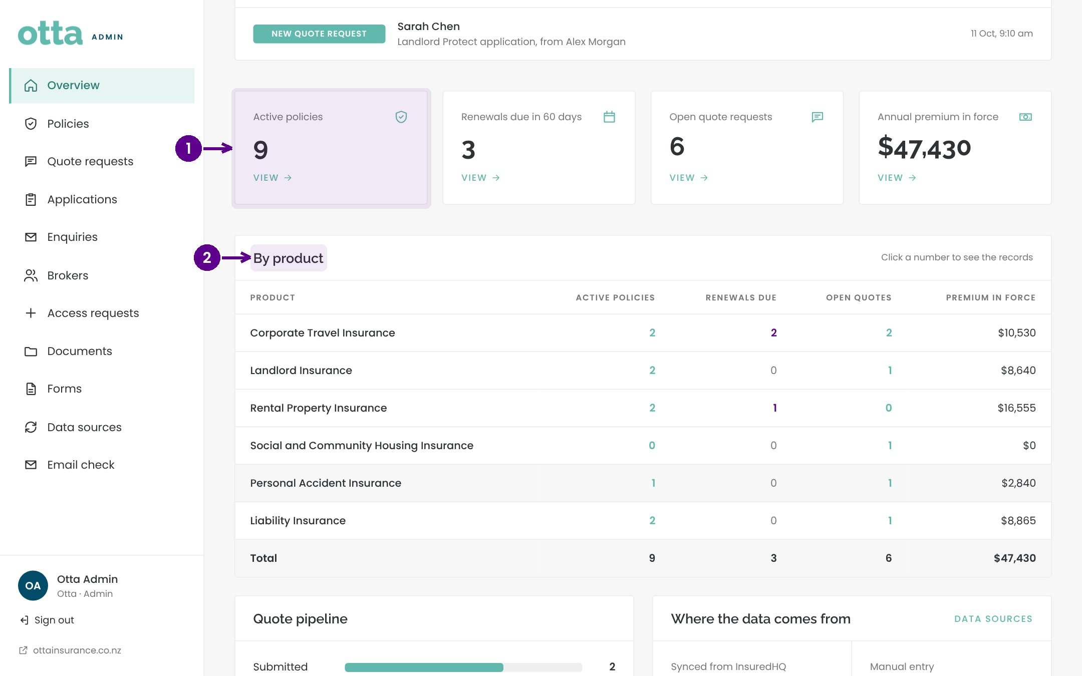
The book at a glance
1
Headline numbers: active policies, premium and renewals. Select one to see the list.
2
The book broken down by product.
Notes:
Further down the overview are the headline numbers for the whole book and a breakdown by product.

Slide 8
Applications and underwriting
02
Every online application and claim lands here, with a first read from the underwriting assistant.
Notes:
Applications and underwriting. Every online application and claim lands here, with a first read from the underwriting assistant.

Slide 9
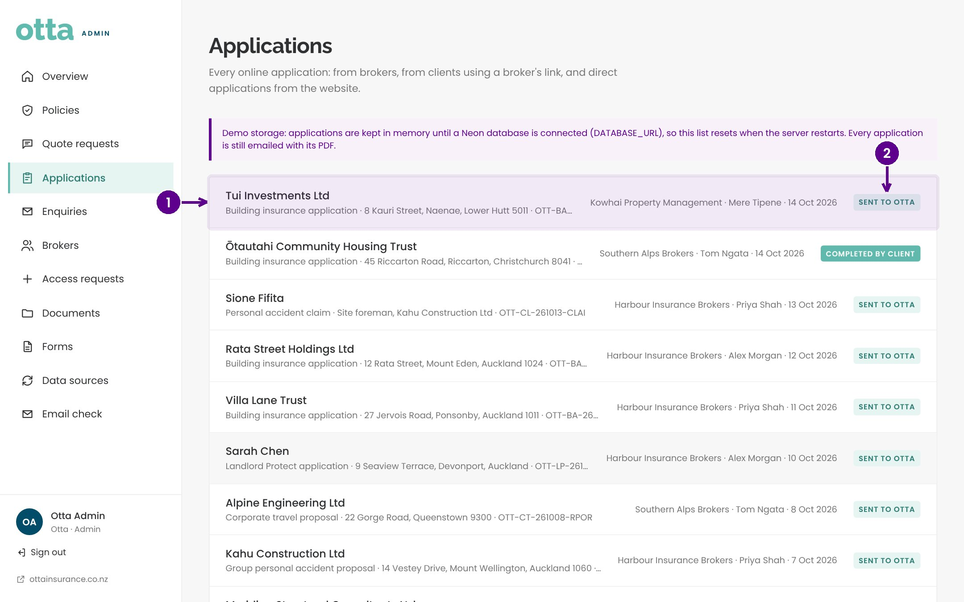
The applications list
1
Each application or claim, newest first. Select one to open it.
2
Its status: new, in review, quoted and so on.
Notes:
Applications lists every online form submitted by brokers or by their clients through a secure link. Each row shows the insured, the product, the broker and the status. Select a row to open it.

Slide 10
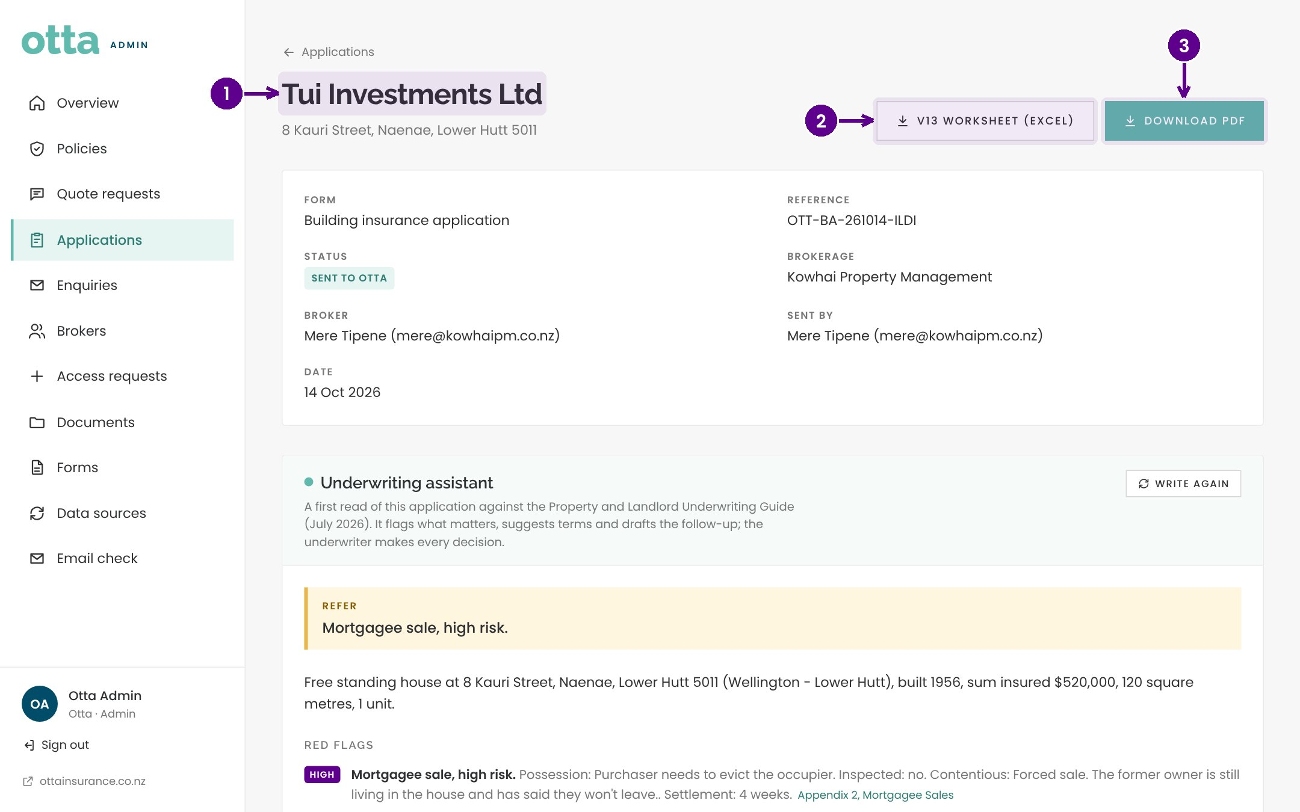
Opening an application
1
The insured and the reference.
2
V13 worksheet downloads the spreadsheet, already filled in.
3
Download PDF saves the application as submitted.
Notes:
At the top of each application is the insured name and reference, with buttons to download the filled V13 worksheet and the application PDF.

Slide 11
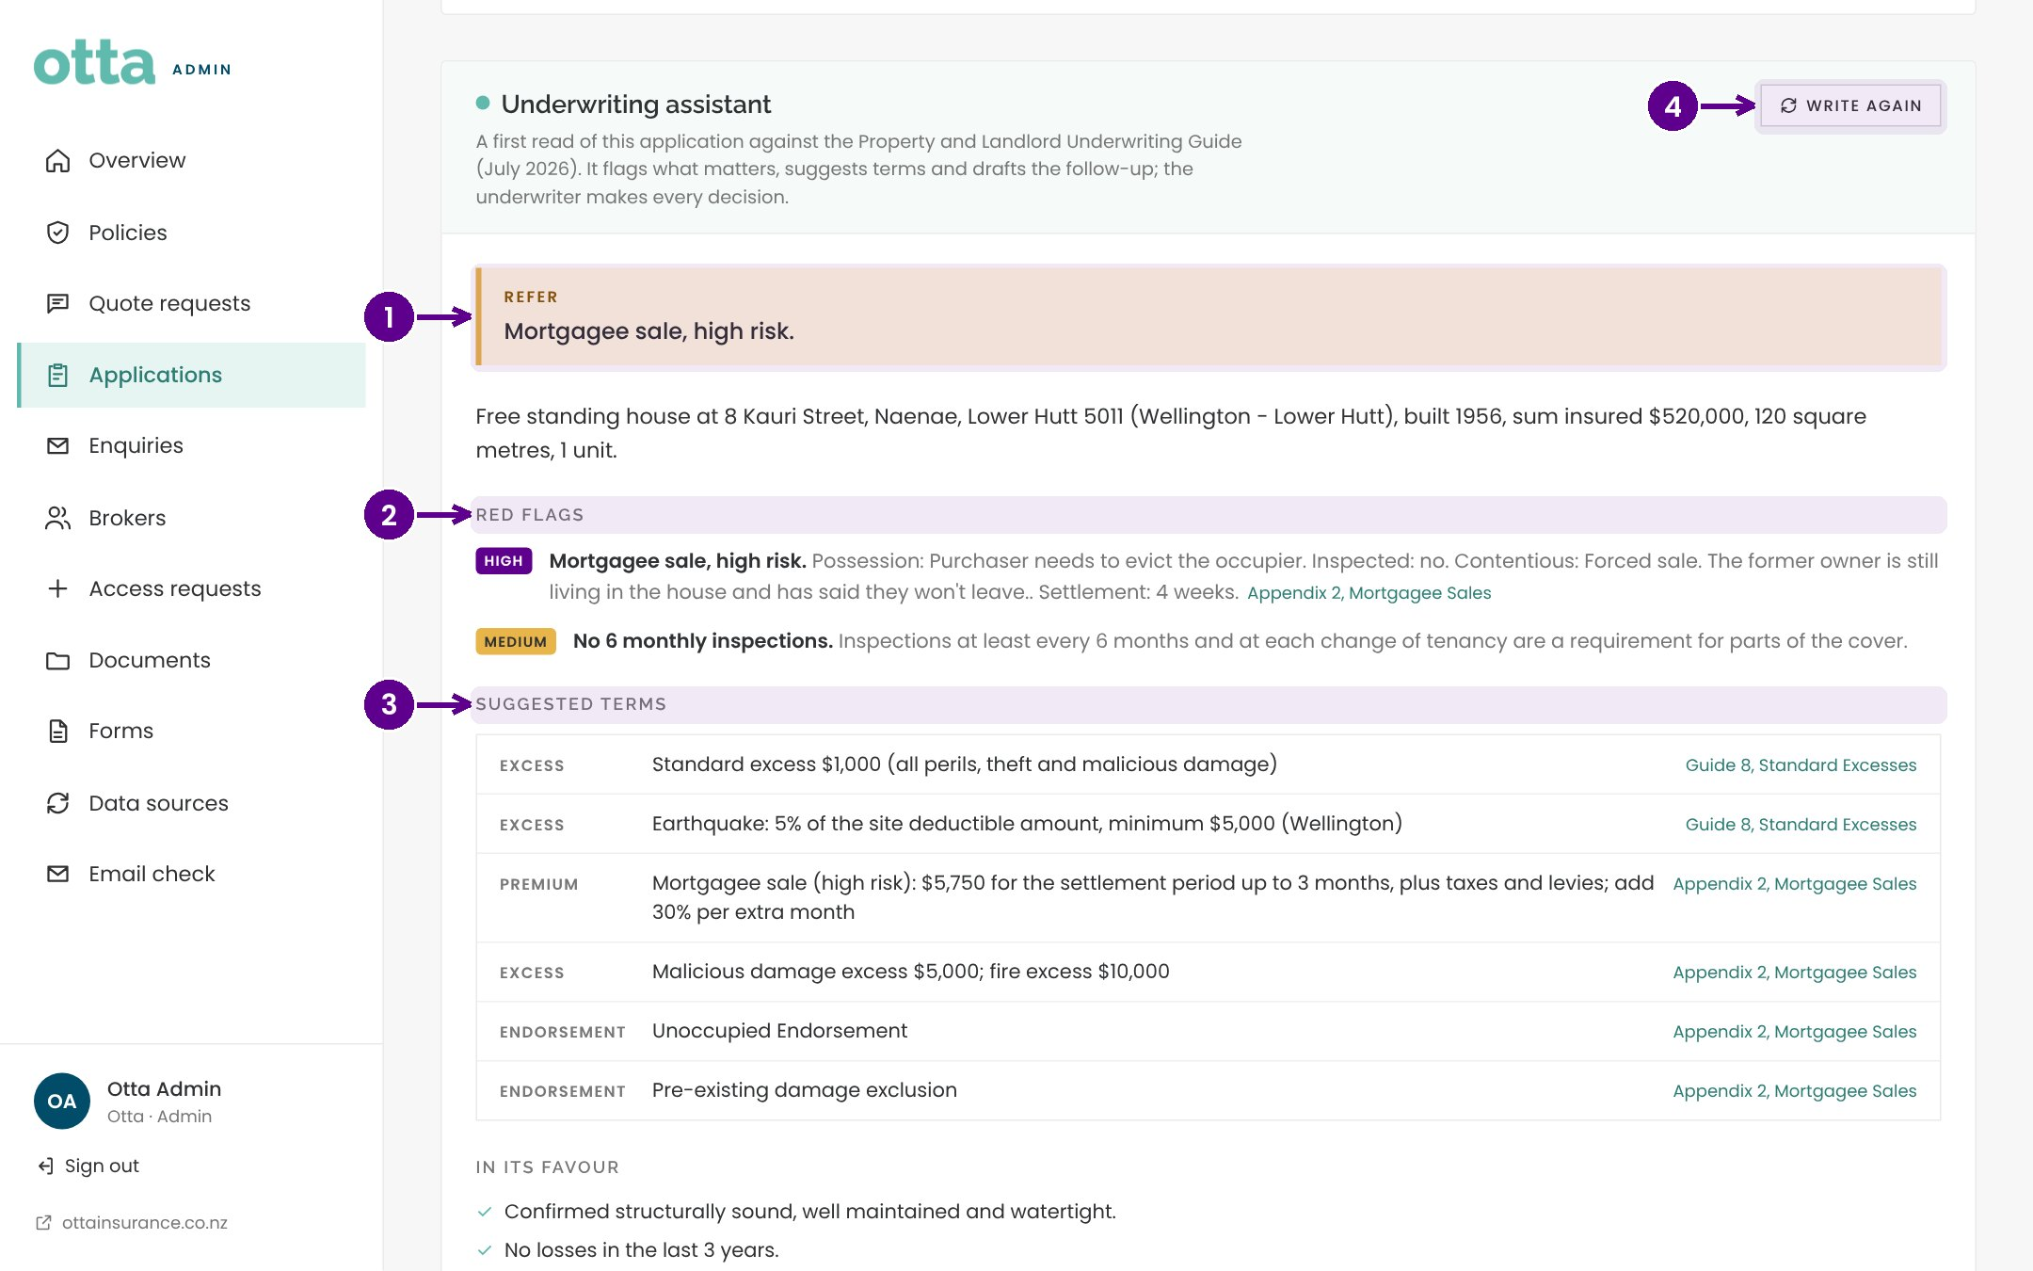
The underwriting assistant
1
The headline: accept, refer or decline, with the main reason.
2
Red flags against the Property and Landlord Underwriting Guide.
3
Suggested terms, each linked to the section of the guide it comes from.
4
Write again refreshes the brief after changes.
Notes:
The underwriting assistant reads each application against the Property and Landlord Underwriting Guide. It gives a headline recommendation, lists any red flags, and suggests excesses, premiums and endorsements, each with the guide section it relies on. It is a first read only. The underwriter makes every decision.

Slide 12
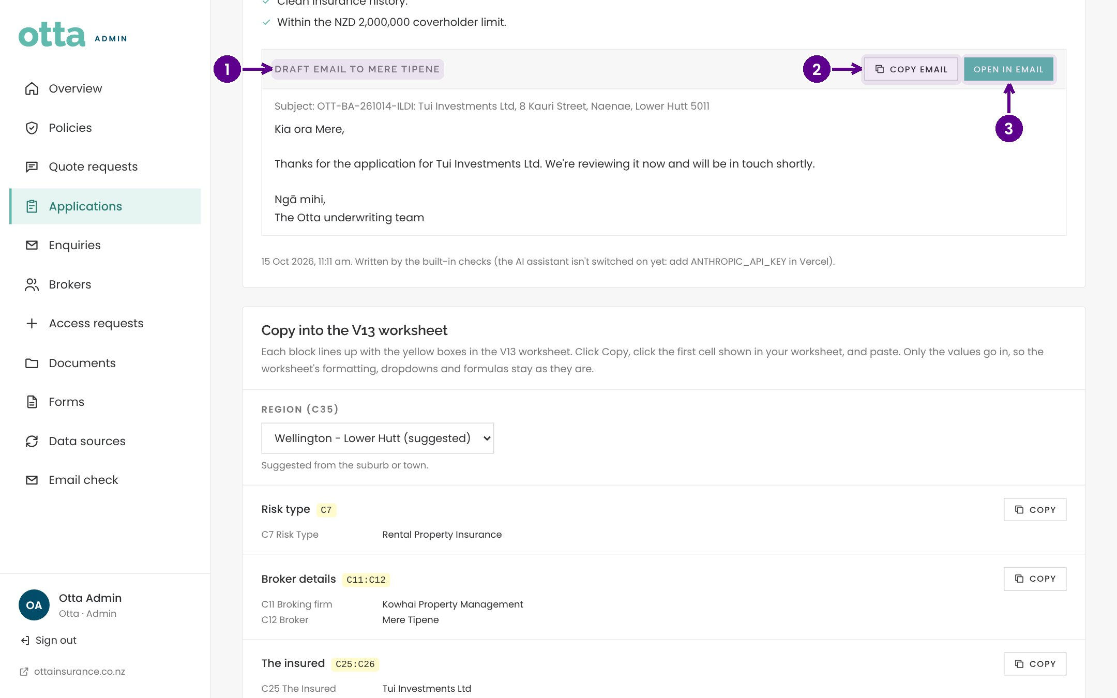
Following up with the broker
1
A draft email to the broker, asking for anything still missing.
2
Copy email to paste it into your own email.
3
Open in email starts a new message with it filled in.
Notes:
The assistant also drafts a follow up email to the broker. Read it, change anything you like, then copy it or open it straight in your email.

Slide 13
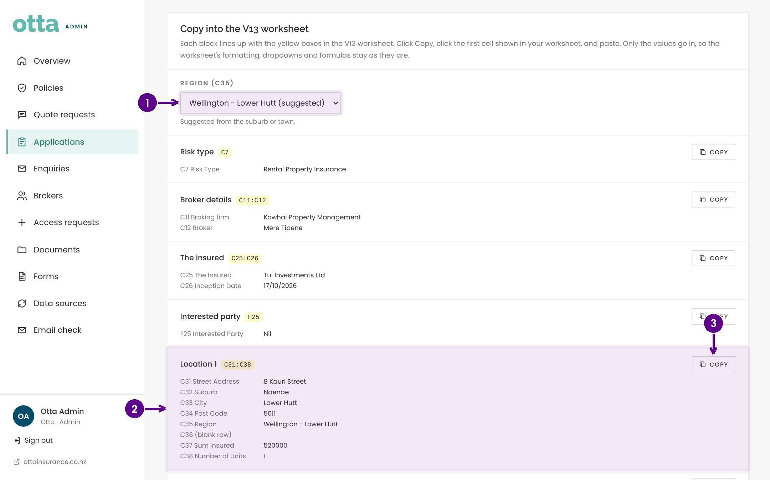
Copying into the V13 worksheet
1
Choose the rating region. The suggested one comes from the suburb or town.
2
Each block lines up with the yellow boxes in V13.
3
Copy, then click the first cell in V13 and paste.
Notes:
Copy into the V13 worksheet lets you fill the rating spreadsheet without retyping. Check the rating region first: it is suggested from the address but you can change it. Then copy each block and paste it into the first matching yellow cell in V13. Only the values go in, so the worksheet's own formulas and dropdowns stay as they are.

Slide 14
Enquiries and brokers
03
Website enquiries, new broker sign ups and the brokerages we work with.
Notes:
Enquiries and brokers. Website enquiries, new broker sign ups and the brokerages we work with.

Slide 15
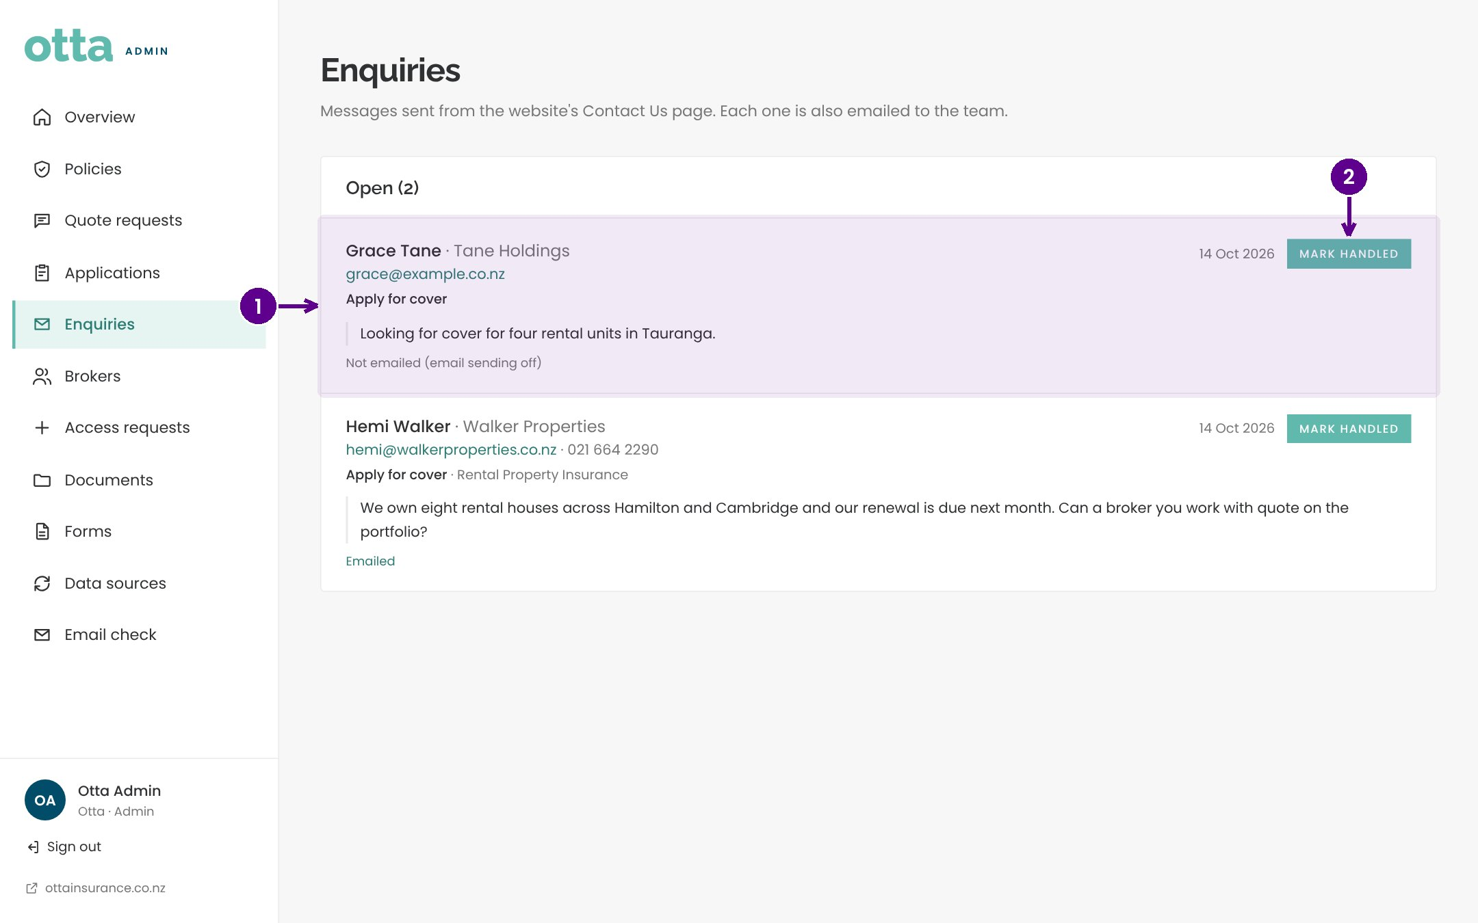
Website enquiries
1
Each enquiry from the Contact Us page, with the message and contact details.
2
Mark handled once you've replied.
Notes:
Every enquiry from the website Contact Us form appears here as well as by email. Reply to the visitor, then select Mark handled so the team knows it is done.

Slide 16
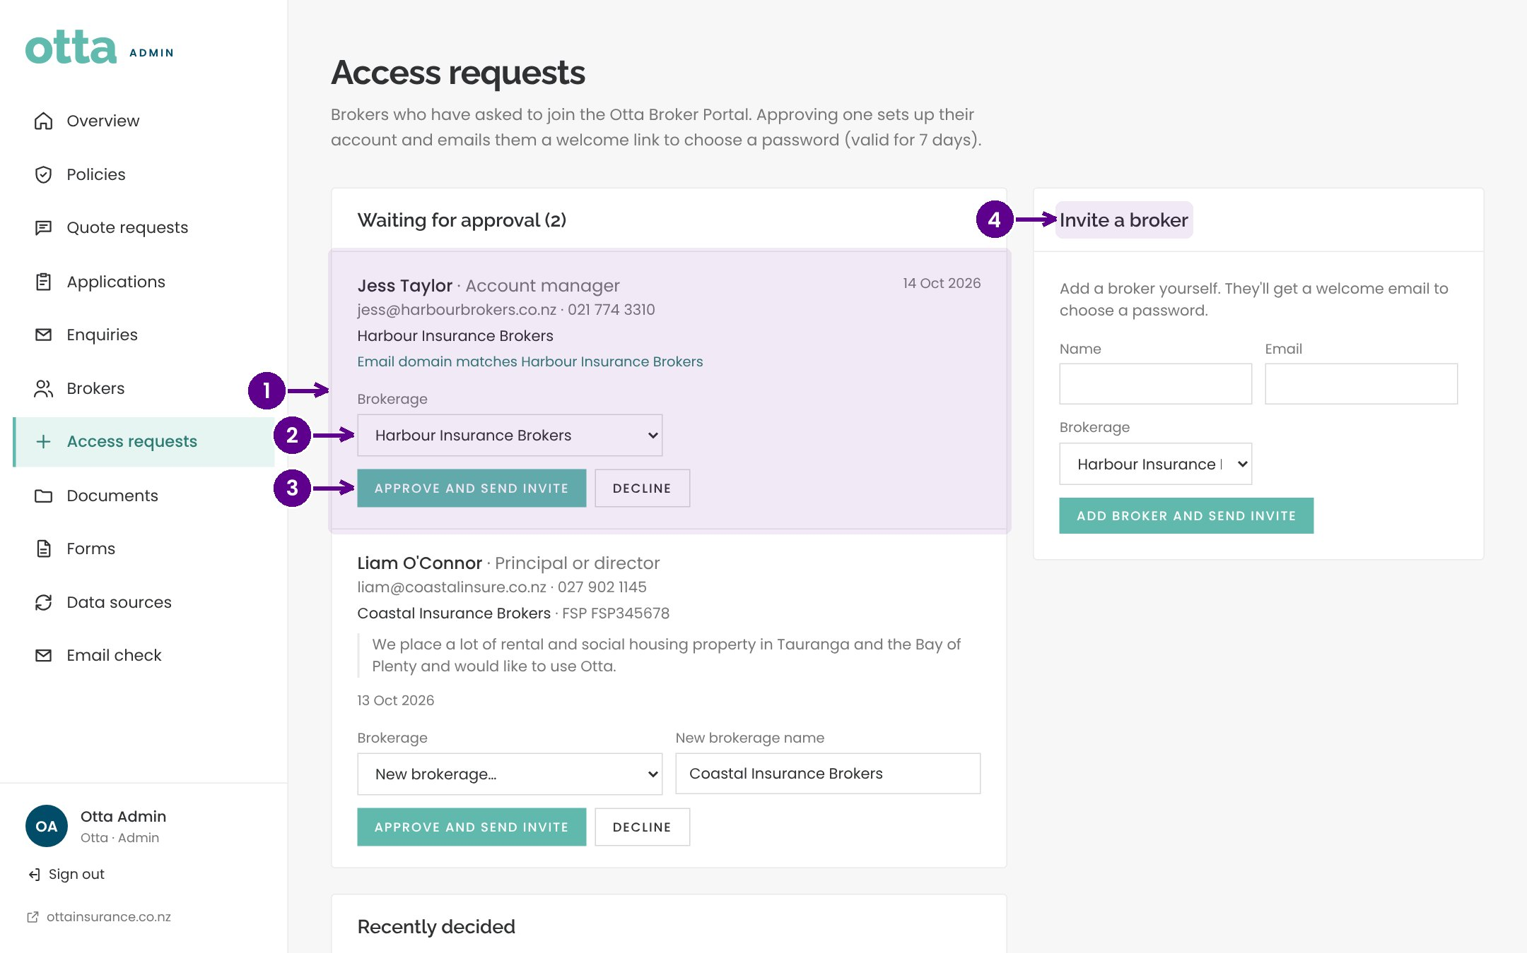
Approving broker portal access
1
A broker who has asked to join the portal.
2
Choose their brokerage, or create a new one.
3
Approve and send invite emails them a welcome link to set a password.
4
Or invite a broker yourself.
Notes:
When a broker asks for portal access, they appear under Access requests. Check their details, choose the brokerage they belong to, and approve. They receive a welcome email with a link to set their password and the broker guide. The link lasts 7 days. You can also invite a broker directly with the form on the right.

Slide 17
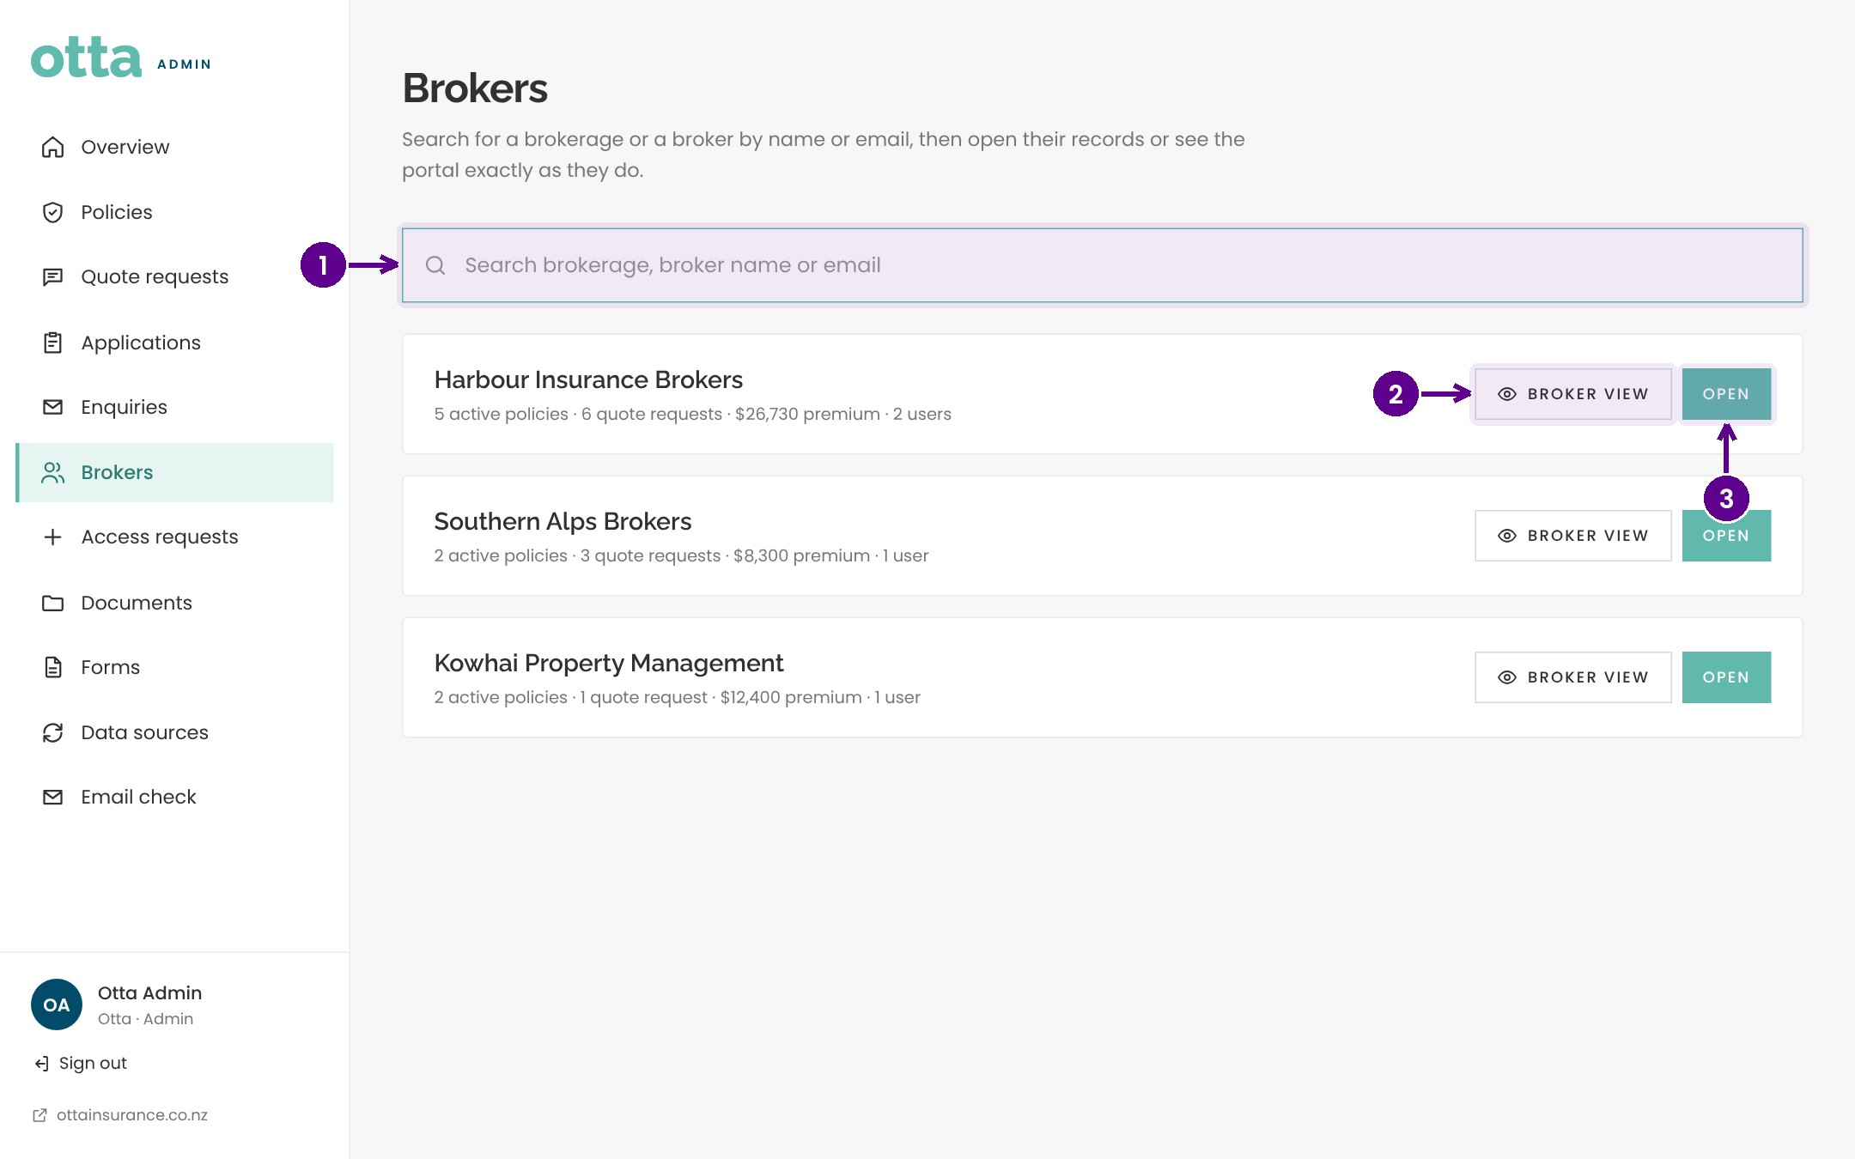
Brokers
1
Search brokerages and brokers.
2
Broker view shows the portal exactly as that broker sees it.
3
Open a brokerage to see its people, quotes and policies.
Notes:
Brokers lists every brokerage and its people. Broker view is useful when a broker calls with a question: you see exactly what they see.

Slide 18
Quotes, policies and email
04
From quote to bound policy, and making sure our emails arrive.
Notes:
Quotes, policies and email. From quote to bound policy, and making sure our emails arrive.

Slide 19
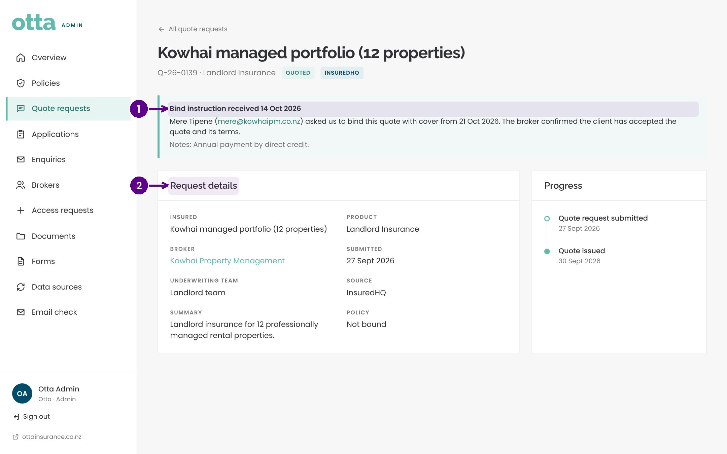
A bind instruction
1
The broker's instruction to bind, with the inception date and any notes.
2
The original request details.
Notes:
When a broker accepts a quote in the portal and instructs Otta to bind, the quote shows a bind instruction banner, and you'll see a celebration on the overview. Bind the policy in the usual way, then update the quote.

Slide 20
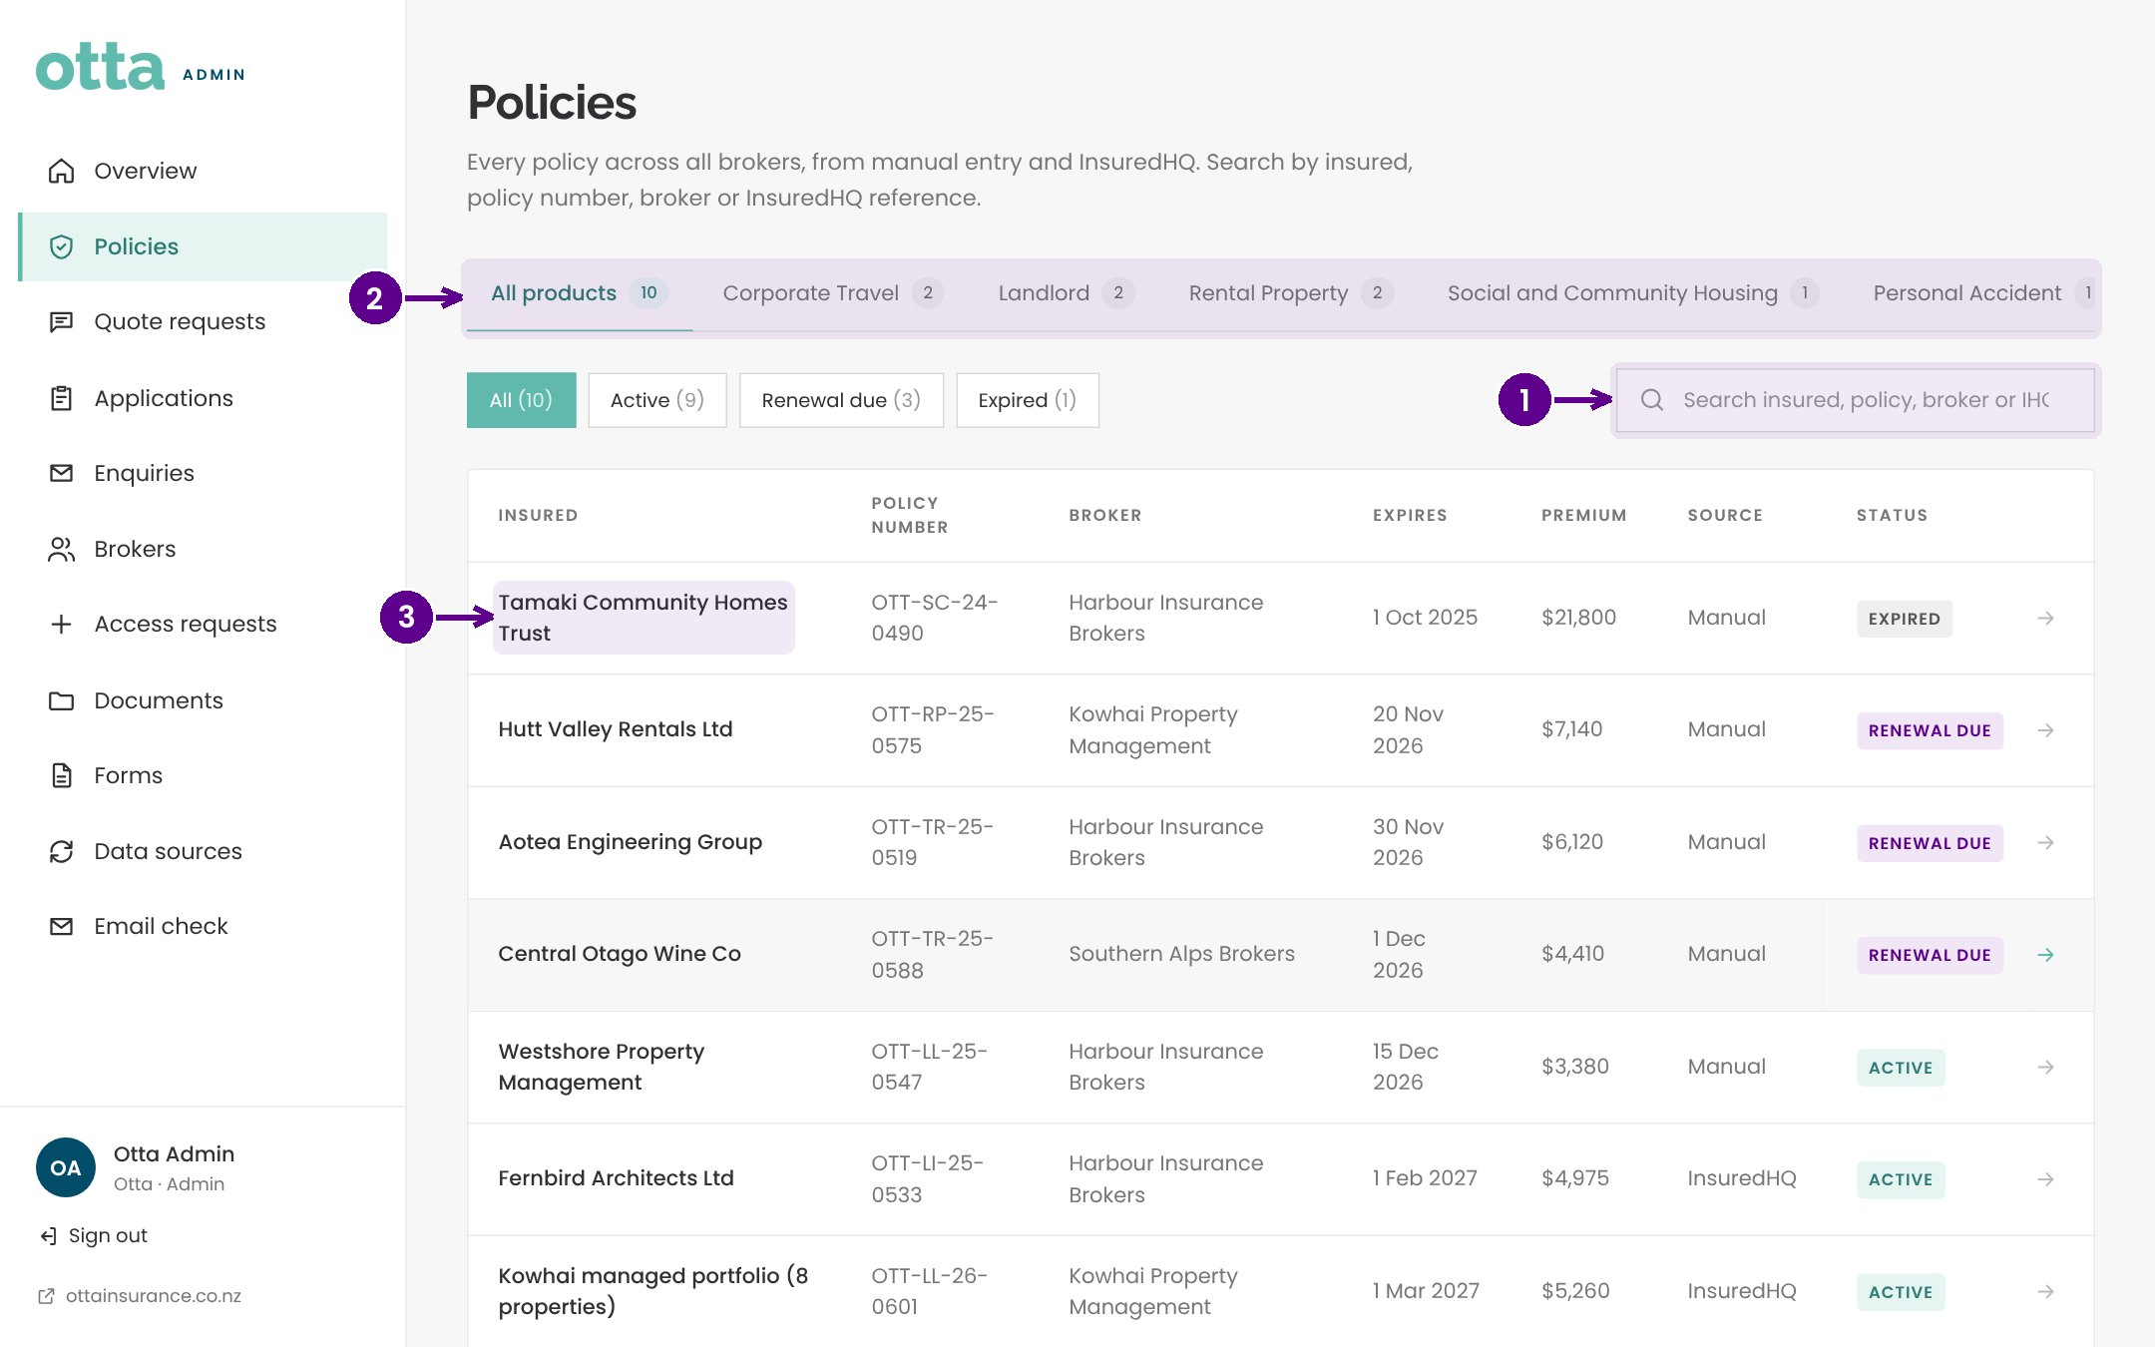
Policies
1
Search by insured, policy number, broker or InsuredHQ reference.
2
Filter by product.
3
Select a policy to see its details.
Notes:
Policies holds every policy across all brokers, from manual entry and InsuredHQ. Search, filter by product or status, and select a policy to open it.

Slide 21
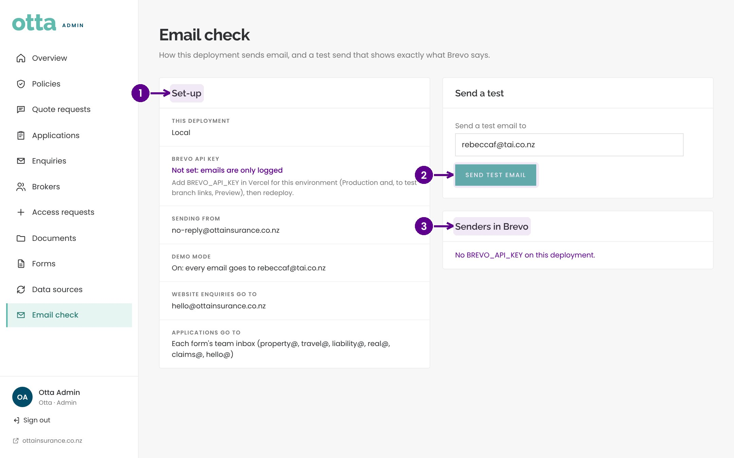
Email check
1
Set up: whether email sending is switched on.
2
Send test email to check delivery end to end.
3
The senders that must be verified in Brevo.
Notes:
If emails aren't arriving, start here. Email check shows whether sending is switched on, lets you send yourself a test email, and lists the sender addresses that must be verified in Brevo, our email service. If the test fails, the page shows the reason Brevo gave.

Slide 22
Key points
Start each day on the overview: banners show what's waiting, Live activity shows what's new.
✓
The underwriting assistant gives a first read. The underwriter makes every decision.
✓
Copy into V13 fills the rating worksheet without retyping.
✓
Approve broker access from Access requests; the broker gets a welcome email and the guide.
✓
Notes:
Key points. Start each day on the overview: banners show what's waiting, Live activity shows what's new. The underwriting assistant gives a first read. The underwriter makes every decision. Copy into V13 fills the rating worksheet without retyping. Approve broker access from Access requests; the broker gets a welcome email and the guide.

